Slide 1
Team 4
SudokuPlus

Slide 2
Team Members:
Mitchell Baer – Logic/Unit Testing
Matt Dean-Hall - GUI
Eric Celerin – Server/User Thread/GUI

Slide 3
User Stories:
-As a user, I want a solve function to get a solution to the puzzle.
-As a user, I want a connection to a server for multiplayer capabilities.
-As a user, I want a set of rules to insure the other users don’t cheat or break the rules.
-As a user, I want a GUI that makes my experience more pleasant.
-As a user, I want extended GUI features (scrolling, options, colors, etc).
-As a user, I want a generate my own puzzle option to ensure unique user experience.

Slide 4
Sprint 1:

Slide 5
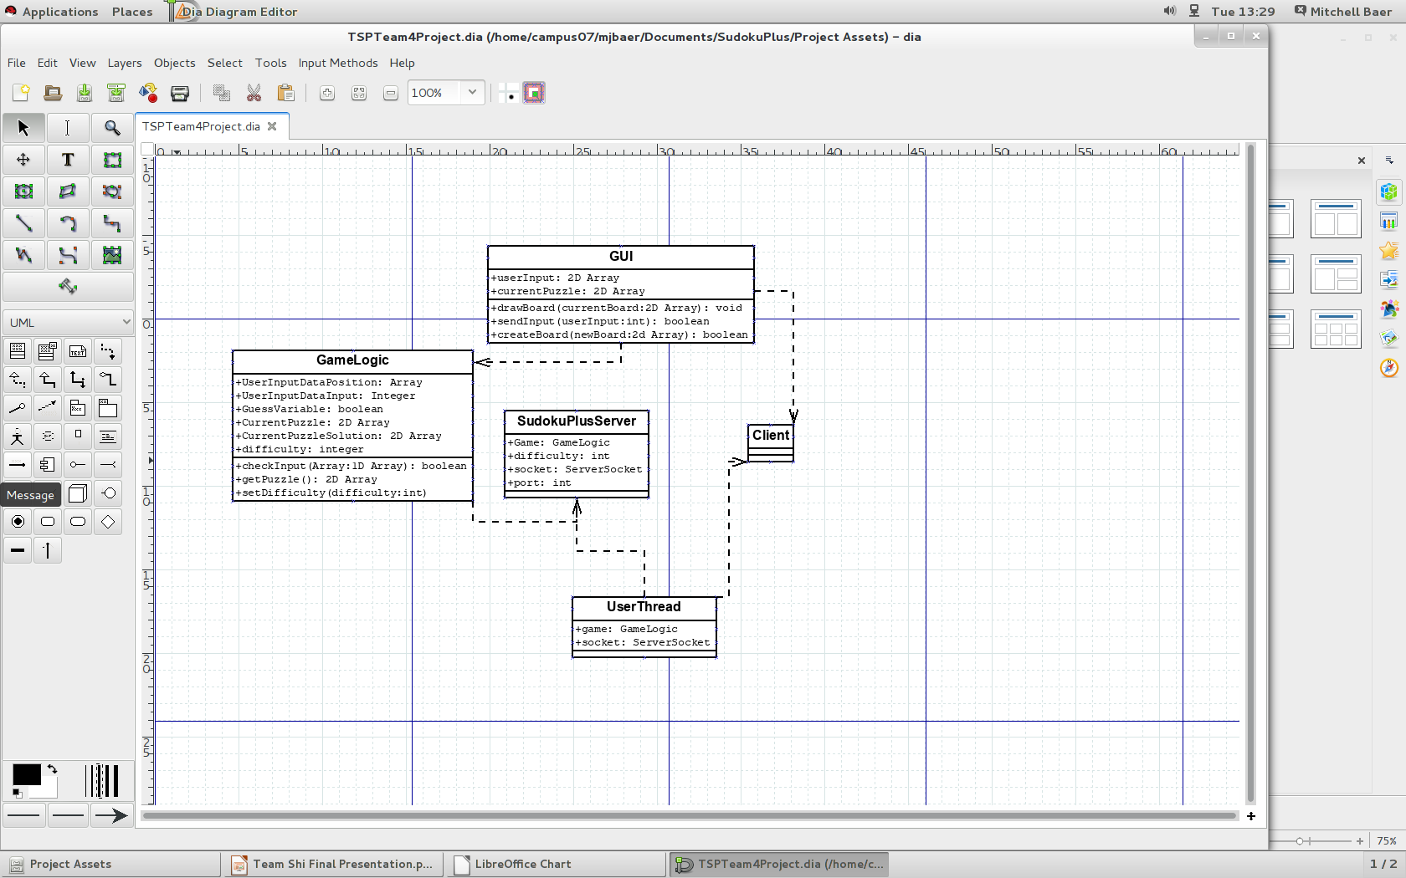

Slide 6
Good:
Developed a good plan (Diagrams) – When we were designing our application, we spent a good deal of time figure out what exactly we needed to do to stay busy and what was important versus what could be added in if we needed to, etc.
Finished all of base code (GameLogic) – With all applications, a good base is fundamental. The GameLogic code is referenced a lot throughout all of the code, so if there was a small bug deep down, it needed to be fixed.
Made better goals for Sprint #2. - We figured out what worked and what didn't and improved on that.

Slide 7
Bad:
Git-hub – Only one member had experience.
Timing – Didn't dedicate very much time towards actual programming. - We deemed it important to develop a good plan in order to make sure the application was the best it could be in the given time. Planning took a week, so now we only had 5 weeks of actual development time.
Minor bugs to work through with getting everyone's code working together – Making sure variables were correct, get/set methods, etc. All had to work together.
Burn-down Chart – We all don't have much experience with group projects, so we over budgeted everything, so our burn-down chart looks a little different from most peoples.

Slide 8
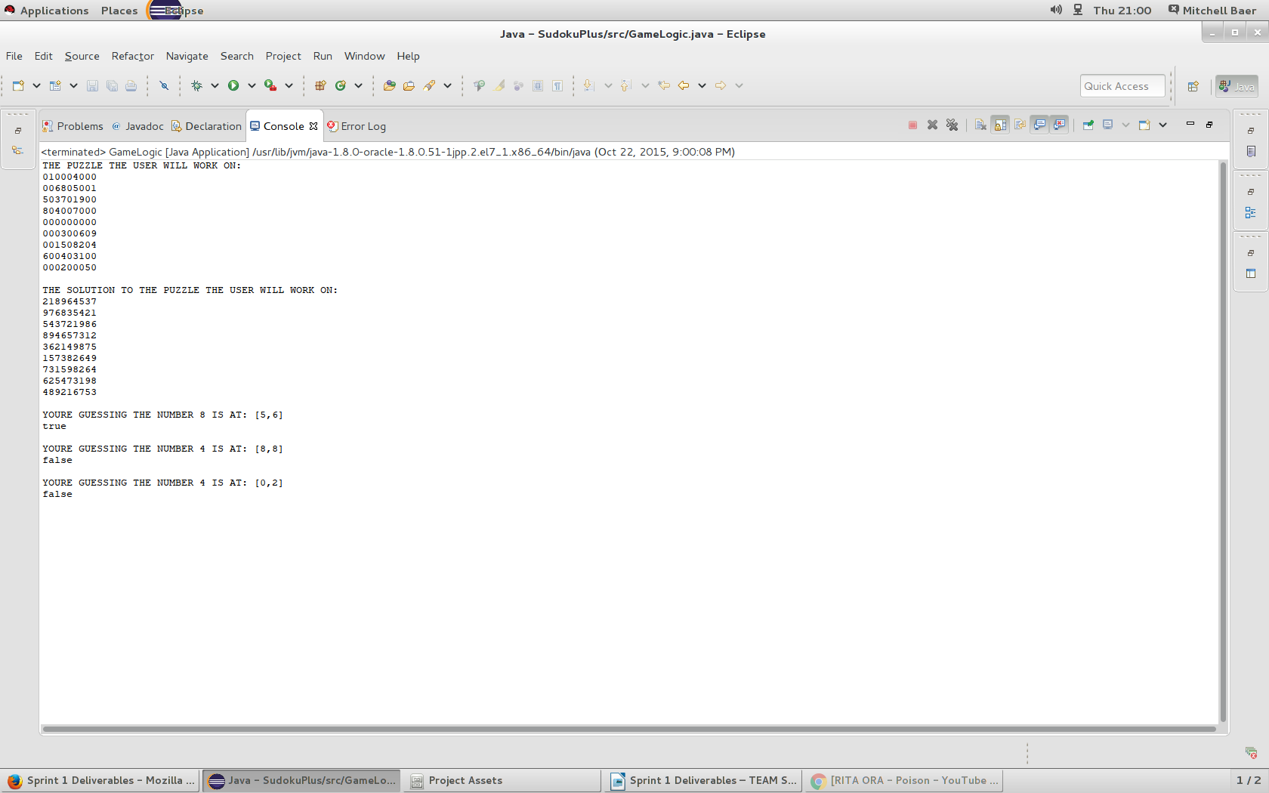

Slide 9
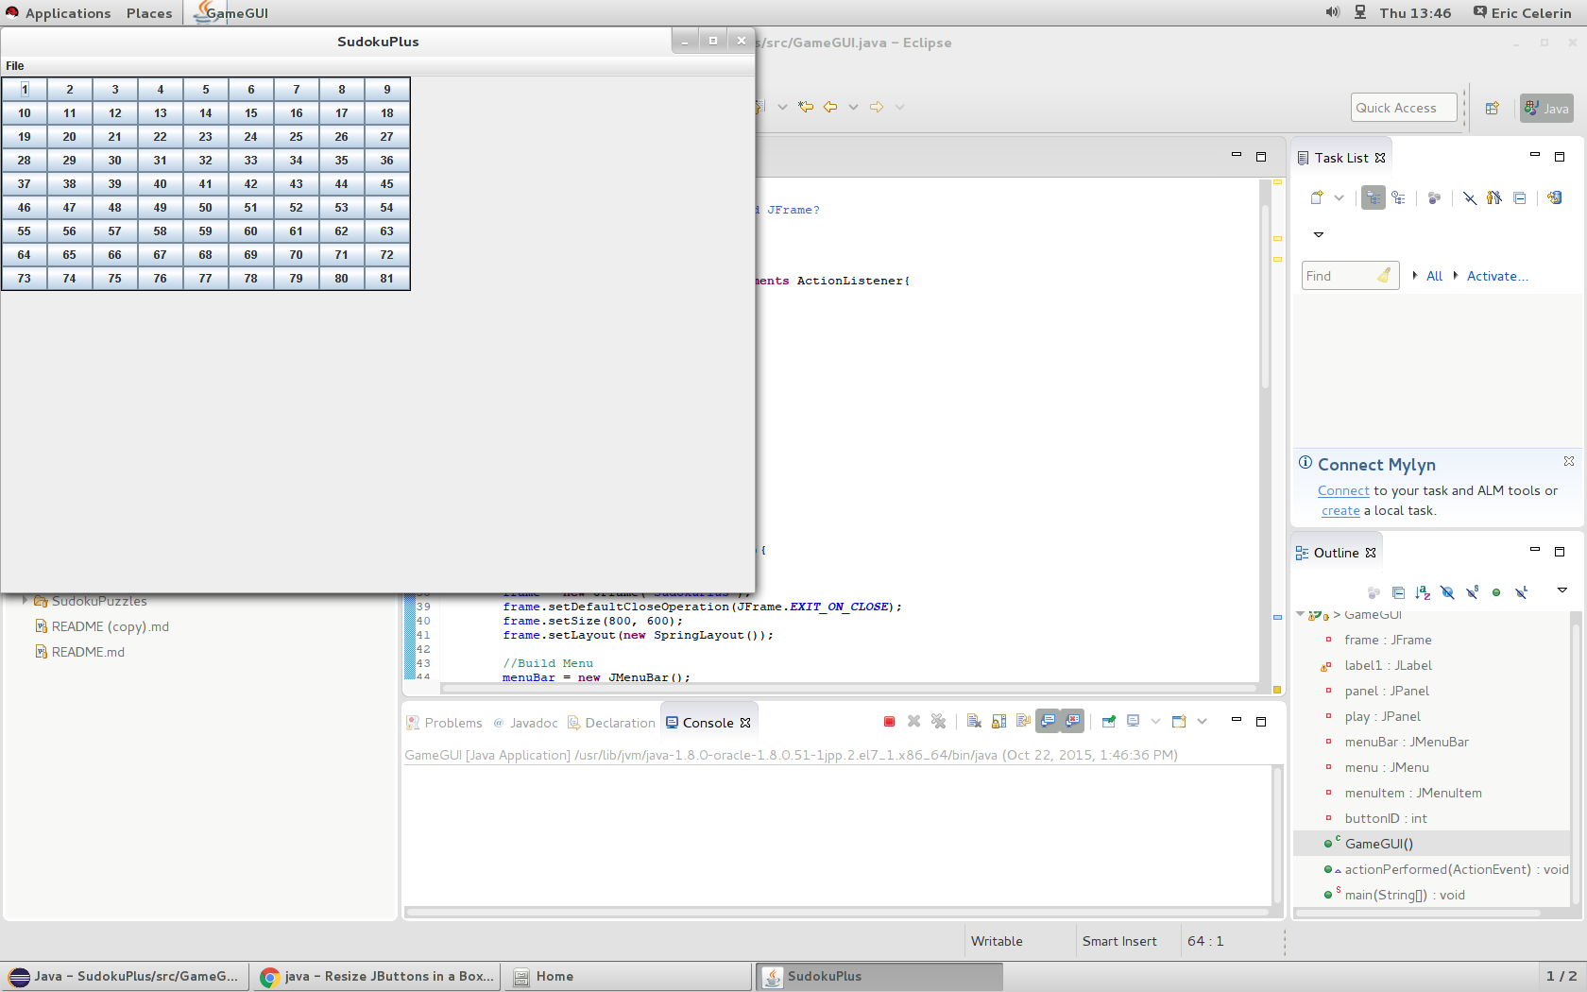

Slide 10
Burndown Chart for Sprint 1:

Slide 11
Sprint 2:

Slide 12
Good:
Working Application – By the end of Sprint 2, we had an application that was playable. Some features were missing, but it could be interacted with.
Increased productivity – After Sprint 1 and having set goals, our productivity was way more than the first sprint. Partially because we had more time, but mostly because we had goals in mind.
Added features – Remote server, incorrect guess, highlighting numbers, working GUI, etc.

Slide 13
Bad:
More minor bugs – We added a lot of code in Sprint 2, so there were a few minor GUI bugs to iron out along the way. Some of them are still in there.
Clock – Our application utilizes the clock. If this clock is off, things won't update in time (too slow or too fast), etc. It also has online capabilities, so the clock serves an important role there. It pings the server for updates.
Changed focus a bit – We had to figure out what we needed to get done and what couldn't get done, so we changed our focus a little bit.

Slide 14
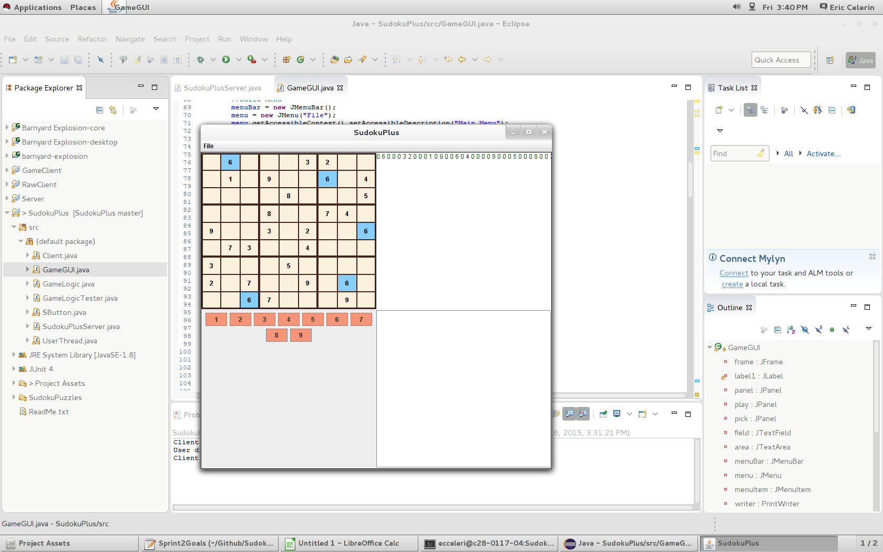

Slide 15
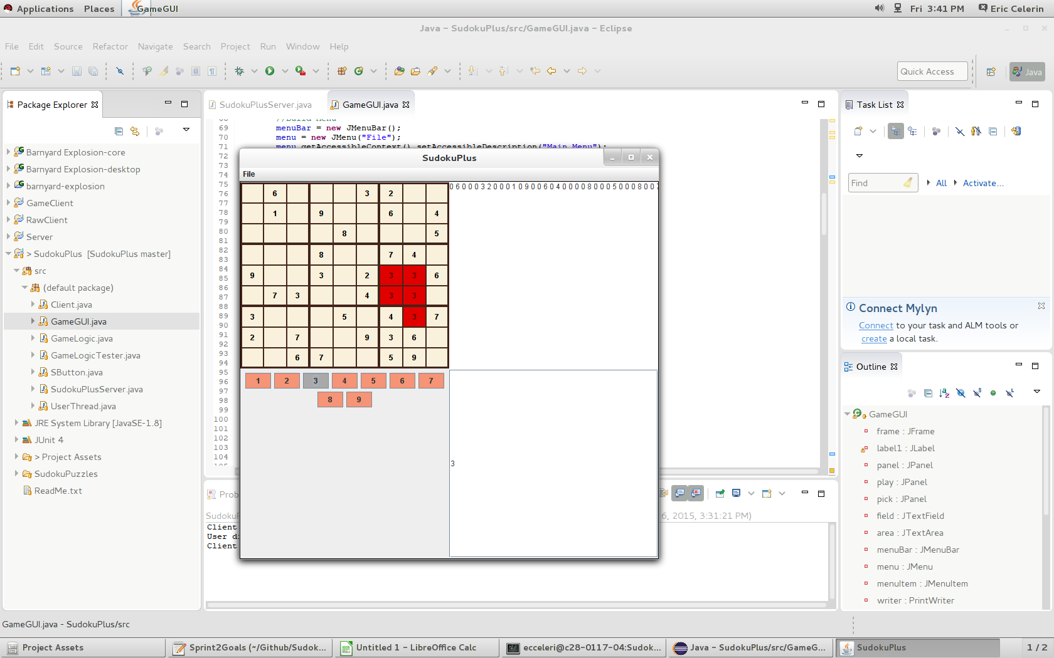

Slide 16
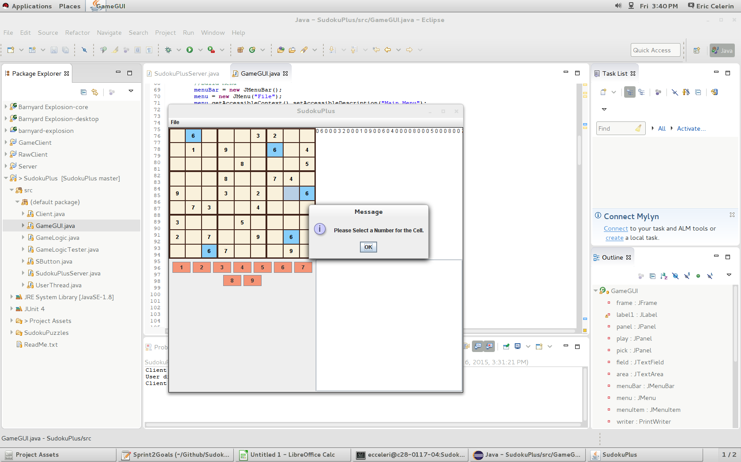

Slide 17
Burndown Chart for Sprint 2:

Slide 18
Unit Tests:
We took advantage of J-Unit for our unit tests.
As opposed to what was seen previously, these are actual unit tests.
One thing we had to keep in mind: For most of our tests, we had to check whether or not they failed them. By failing them, they were in fact passing the tests, so it took a different way of thinking to make sure they were set up correctly.
DEMO OF UNIT TESTS

Slide 19
Sprint 3:

Slide 20
Good:
Even more added features – This final sprint was the one where we spent most of the time adding features. Timer, win condition, usernames, etc.
More Unit tests – Had to add more methods to the GameLogic, so that meant more unit tests could be written. Ensured the code was working correctly still.
Increased productivity – Like sprint 2, we increased our productivity even more so that in sprint 2. We got more done and optimized a few different things.

Slide 21
Bad:
Serious Git Issue – Other than initially learning git, we only had one disaster and it happened this sprint. Almost lost hours of work. Had to fix the repo and revert it back to a previous version. Wasn't too bad fixing, but was definitely scary.
Bugs – Nothing really serious here. These were expected. When you add a feature, very rarely do they work the first time over. Just took some minor tweaking to get all of the code running together again.

Slide 22
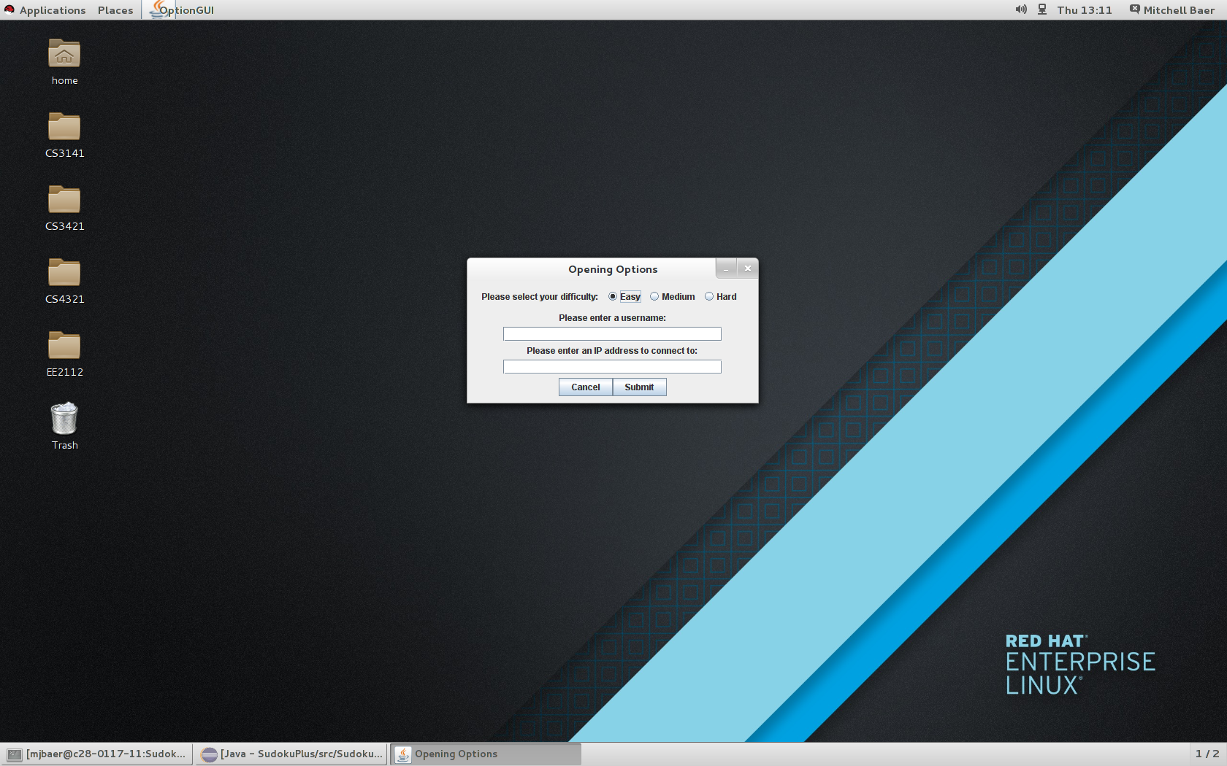

Slide 23
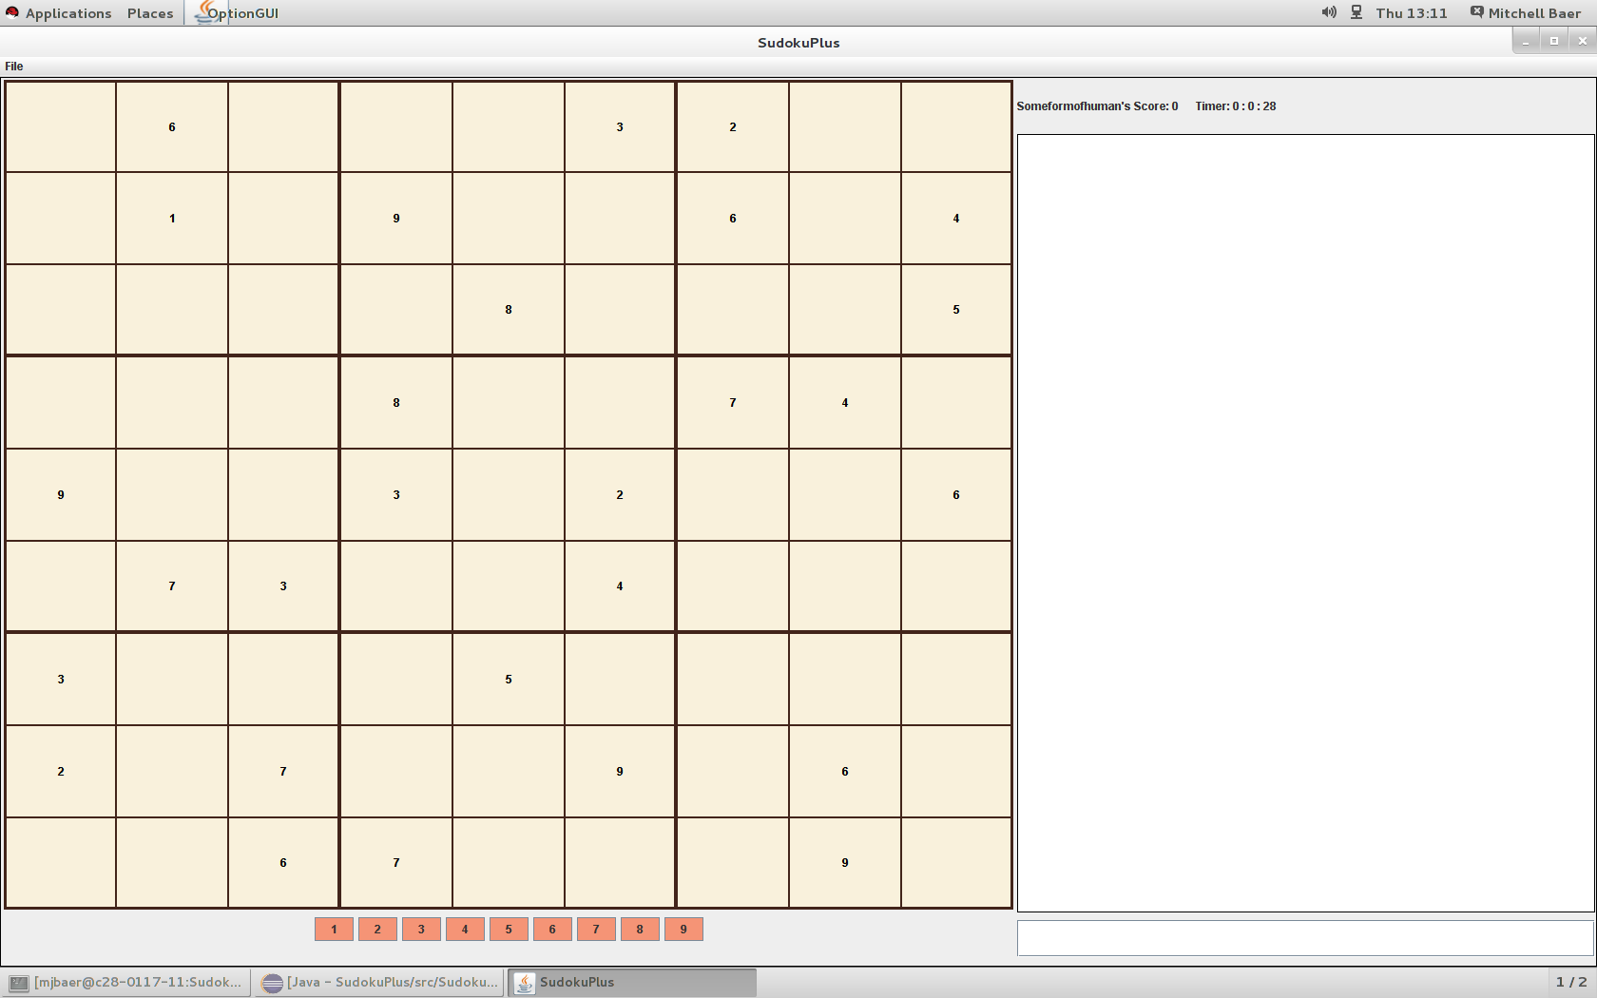

Slide 24
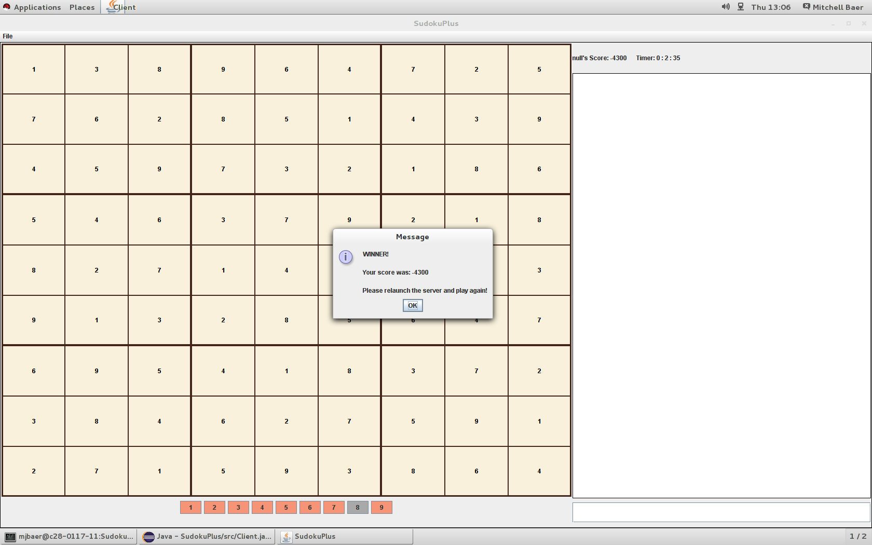

Slide 25
Burndown Chart for Sprint 3:

Slide 26
Neat Code We Like

Slide 27
SCRUM:
Communication: Text, Email
Meetings: Met 5 times a week (MWF in Class, TR outside)
Difficulties: New to SCRUM. Tried to follow as closely as possible.
Development Process: Set achievable goals which allowed the Sprints to go smoothly. Everybody had set roles, but helped one another out if needed. Reflection on the previous days work and what the goals of that day were. Etc.

Slide 28
What We Learned:
Project Planning – Our project didn't extend past our experience level, but it provided enough of a challenge that it wasn't done in one day.
Setting Goals – Initially, our goals (user stories) were very vague. They developed as the project went along and certain demands needed to be met.
Communication – Our meetings were productive, everybody asked plenty of questions and made it clear what they were going to work on that day.
Git – Git is extremely difficult to master, but extremely useful, so exposure like this was good to break the ice. We didn't use it as efficiently as possible, but we figured out a way that worked for us and only ran into issues a few times.
Programming – Game development, optimization, little things to make your life easier as a programmer.

Slide 29
Finished Product Demo

Slide 30
Questions?

